Slide 1
Lecture 35 – Prim’s Algorithm
CST370 – Design & Analysis of Algorithms
Dr. Byun
Computer Science

Slide 2
Lecture Objectives
After completion of this lecture, you will be able to
  solve the minimum spanning tree (= MST) problem using the Prim’s algorithm.

Slide 3
Chapter 9: Greedy Technique
9.1 Prim’s Algorithm
9.2 Kruskal’s Algorithm
9.3 Dijkstra’s Algorithm
9.4 Huffman Trees and Codes

Slide 4
Spanning Tree – Definition
Watch this video first
  https://youtu.be/s5BB7Asirdw (3:02)
A spanning tree of a connected graph is its connected acyclic subgraph that contains all vertices in the graph.
  It’s possible to have several spanning trees for a connected graph.

Slide 5
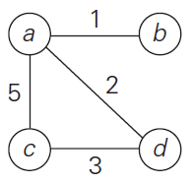
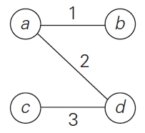
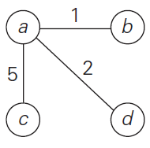
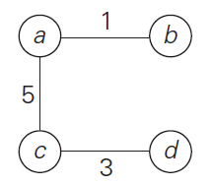
Spanning Tree – Example
A sample connected graph
Three different spanning trees of the sample connected graph

Slide 6
Minimum Spanning Tree (MST)
MST is a spanning tree with the smallest weight among all possible spanning trees of a graph.
Example
Sample Graph
This is the MST of sample graph

Slide 7
MST Example in Our Life
Suppose we plan to build a new highway system in California as shown below.
  The number on each edge is the cost to build each section.
1
SF
SJ
5
2
7
SD
LA
3
Now, let’s assume that we should cut the total construction cost.
  But drivers should be able to go from one city to all other cities.
  How would you construct it with the minimum cost?

Slide 8
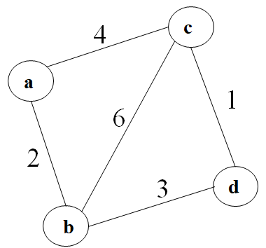
Exercise
Draw the MST of the following graph.

Slide 9
Prim’s Algorithm to Find a MST
Start with a tree T₁ which is composed of a vertex.
Grow T₁ by adding one vertex at a time such as T₂, T₃, …, T_{n}.
Construct T_{i+1} from T_{i} by adding a vertex not in T_{i} that is closest to those already in T_{i}
  // Note the step 3 uses a greedy technique
  // because we select the closest vertex.

Slide 10
Resource
Watch the following video to get the basic idea of the algorithm:
  http://y2u.be/cplfcGZmX7I (2:16)
  You don’t need to understand the pseudocode to implement the algorithm.

Slide 11
Example
Tree Vertices
Remaining Vertices

Slide 12
Additional Resources
Read the following document to understand the operation of Prim’s algorithm.
  https://bit.ly/2SGD3Fc
If you need more info, watch this video
  https://youtu.be/YOoPayYi06k

Slide 13
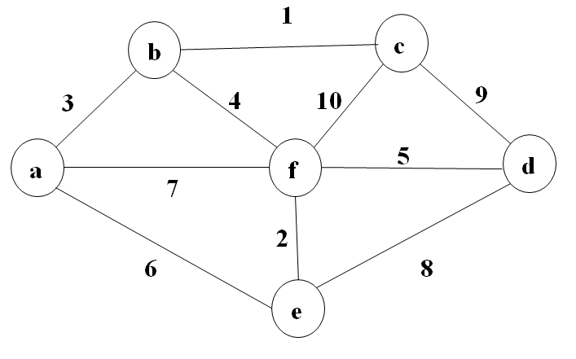
Exercise (1 of 2)
Find the MST starting at vertex a.

Slide 14
Exercise (2 of 2)
Tree Vertices
Remaining Vertices
a(-, -)

Slide 15
Puzzle
There are five girls.
  Liza is somewhere between Karen and Monica.
  Exactly one girl is between Barbara and Liza.
  Exactly one girl is between Alice and Karen
  Liza is taller than Monica.

